Slide 1
THE NET PRESENT VALUE METHOD TO VALUE PROJECTS & FIRMS

Slide 2
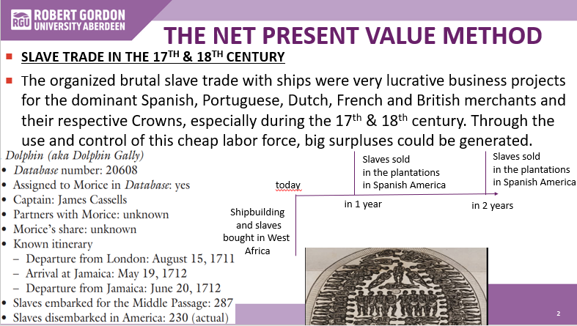
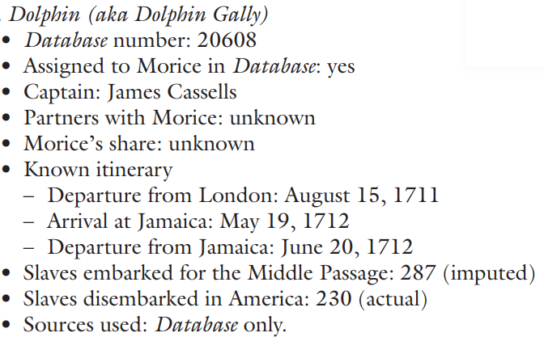

THE NET PRESENT VALUE METHOD
SLAVE TRADE IN THE 17TH & 18TH CENTURY
The organized brutal slave trade with ships were very lucrative business projects for the dominant Spanish, Portuguese, Dutch, French and British merchants and their respective Crowns, especially during the 17th & 18th century. Through the use and control of this cheap labor force, big surpluses could be generated.
Slaves sold
in the plantations
in Spanish America
Slaves sold
in the plantations
in Spanish America
today
in 1 year
in 2 years
Shipbuilding
and slaves
bought in West
Africa

Slide 3




THE NET PRESENT VALUE METHOD
FOOTBALL CLUBS OR PRODUCERS OF MUSIC TALENTS/SHOWS
Today football clubs or producers of talents/shows create value, create superstars in the academies and in collaboration with mass media, like radio, newspapers and TV, which influence public opinion.
Stars sold
to other clubs
Superstars sold
to other clubs
today
Invest in young
talents
(Academies)
in 1 year
in 2 years

Slide 4


THE NET PRESENT VALUE METHOD
PROFESSIONAL TALENTS
Professional schools and employers develop talents as well. The best graduates will earn high salaries.
Higher value on the
job market
Higher value
on the job
market
today
Invest in young
professional talents
(external and internal schooling)
in 1 year
in 2 years
COACHING

Slide 5
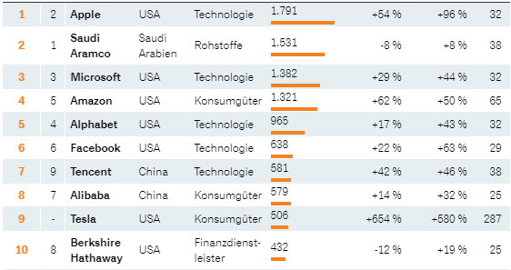
THE NET PRESENT VALUE METHOD
ONLY THE FUTURE MATTERS!
Stock-Performance in 2020
From the valuation of Tesla, already the 9th biggest company in the world, we see that the future profit opportunities support the high valuation of Tesla on the stock market.

Slide 6
THE NET PRESENT VALUE METHOD
CALCULATE THE NPV OF THE PROJECT
Discount Rate (required rate of return): 5% p.a.
+10’000
+10’000
+10’000
today
Year 2
Year 1
Year 3
Initial Investment
- 20’000
+10’000
(1+r)
+10’000
(1+r)²
Present Value Profit in Year 1 +9’524.-
+10’000
(1+r)³
Present Value Profit in Year 2 +9’070.-
Present Value Profit in Year 3 +8’638.-
Sum of Present Values after Deduction of Investment +7’232.-
If the net present value is > 0, the project should be done

Slide 7
THE NET PRESENT VALUE METHOD
HOW TO CALCULATE THE PRESENT VALUE OF A SINGLE FUTURE CASH FLOW
Future Cash Flow in 1 year
(1+r)¹
Present Value
=
Future Cash Flow in 2 years
(1+r)²
Present Value
=

Slide 8
THE NET PRESENT VALUE METHOD
SUMMARY OF THE NET PRESENT VALUE METHOD
The Net Present Value Method looks only at the cash outflows and cash inflow, like the statement of cash flows.
The statement of cash flow looks at the cash flow in one period.
To value projects or (hotel) firms only the future matters. The net present value method looks only at the future cash flows.
The investment will be done only if the Net Present Value (NPV) is greater or equal to zero (NPV >=0). This would mean that we recover the initial investment plus the required interest rate (the discount rate).
For good projects the NPV is greater than 0. In those cases it’s interesting to know the internal rate of return of the project, which is obviously greater than the originally assumed discount rate.

Slide 9
THE NET PRESENT VALUE METHOD
EXERCISE: THE NET PRESENT VALUE METHOD
Exercise: An auto repair shop is considering the purchase of an automated paint spraying machine. The machine will last five years.
Following information is available:
Each year $2,000 will be saved on paint
It will reduce labor costs by $20,000 each year
It will require maintenance costs of $1,000 each year
The machine costs $70,000
The expected residual value is $5,000
The required rate of return is 12%

Slide 10
THE NET PRESENT VALUE METHOD
EXERCISE: THE NET PRESENT VALUE METHOD
Discount Rate = 12%
+21’000.-
+21’000
+21’000
+21’000
+26’000
Initial Investment +70’000.-
today
10
Year 1
Year 2
Year 3
Year 4
Year 5
+21’000
(1+r)
PV Cash Flow in Year 1 +18’750.-
+21’000
(1+r)²
PV Cash Flow in Year 2 +16’741.-
+21’000
(1+r)³
PV Cash Flow in Year 3 +14’947.-
PV Cash Flow in Year 4 +13’346.-
PV Cash Flow im Jahr 5 +14’753.-
+21’000
(1+r)⁴
+26’000
(1+r)⁵
Sum of PVs Year 1-5 +78’537.-
Minus initial investment -70’000.-
The higher the labor costs and the costs of painting, the more valuable will be the project
NPV of Investment 8’537.-

Slide 11
THE NET PRESENT VALUE METHOD
CASE STUDY: THE VALUATION OF A FIRM
The expected lifetime of a firm like Nestlé or Schindler is extremely long (forever, infinity). Therefore, after discounting individual cash flows after a few years, we can assume an annuity thereafter.
Profit
+90’000.-
Profit
+93’000.-
Profit
+96’000.-
Profit
+99’000.-
constant profit
+90’000.-
Discount Rate: 7% p.a.
today
11
Year 1
Year 2
Year 3
Year 4
Year 5 onwards..forever
+90’000
(1+r)
annuity
PV Profit in Year 1 + 84’112.-
+93’000
(1+r)²
+90’000
r
PV Profit in Year 2 + 81’230.-
+96’000
(1+r)³
PV Profit in Year 3 + 78’365.-
PV Profit in Year 4 + 75’527.-
PV Profit in Year 5 + 64’169.-
PV annuity Year 5 + 916’696.-
+99’000
(1+r)⁴
+90’000
(1+r)⁵
+1’285’714
(1+r)⁵
Value of Firm (Sum PVs) +1’300’099.-

Slide 12
THE PRESENT VALUE
THE ANNUITY: THE PRESENT VALUE OF A SERIES OF CASH FLOW
Annuity like a pension or
a food company with constant profits
Present
Value
Future yearly Cash Flow forever
r
=
Present
Value
Future yearly Cash Flow forever
r - g
Assuming a growth rate of 2% In the yearly profits:
=
2%

Slide 13
THE NET PRESENT VALUE METHOD
THE TERMINAL VALUE IN THE PRESENT VALUE CALCULATION
From the previous calculation of the value of the firm, we can see that the last term, the terminal value calculated with the annuity formula, is the most important one.
Of the firm value of CHF 1,3 million, the last term amounts to CHF 0,9 million. This is 70% of the value of the firm.
The forecast of the constant profit from year 5 onwards is very difficult.
It’s therefore recommended to be very conservative with the forecast of this annuity. It should not be too optimistic, otherwise we calculate a value of the firm, which is too high (problem of overvaluation). To be prudent, we could also use a higher discount rate, as the higher interest rate makes the present value smaller.

Slide 14
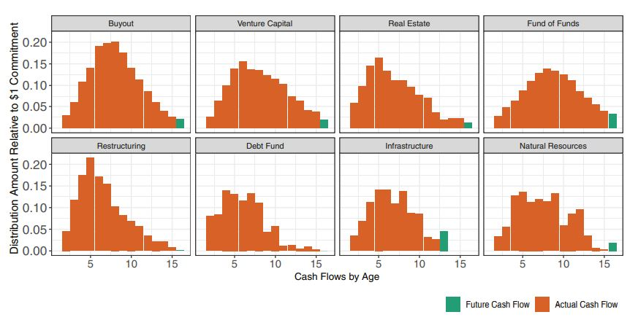
THE NET PRESENT VALUE METHOD
NPV DEPENDS ON THE SECTOR-SPECIFIC TIMING OF THE CASH FLOWS
GUPTA. A., VAN NIEUWERBURGH, S., 2021. Valuing Private Equity Investments. In: Journal of Finance.

Slide 15
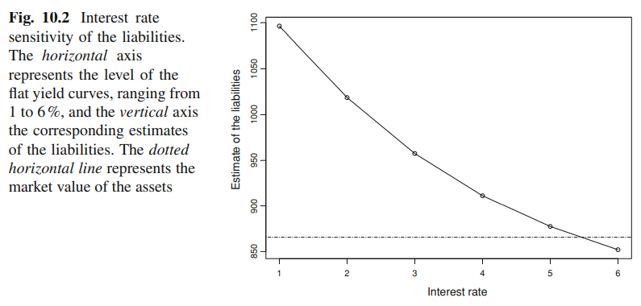
THE NET PRESENT VALUE METHOD
NET PRESENT VALUE TO BE APPLIED TO LIABILITIES AS WELL (AT PENSION FUNDS)
Source: SILVESTROVS, D., LOEF, A.M., 2014. Modern problems in insurance mathematics. Springer

